Slide 1
SUPPORT COMANDER 2.0 VWR International-Germany
Jörg Burkhardt , 24.02.2012

Slide 2

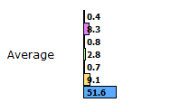
Commander – Overview
History
start of the first Support Commander was in 2005
actually approx. 5600 documents available
- total Downloads since 2005 approx. 100.000 !!!

Slide 3
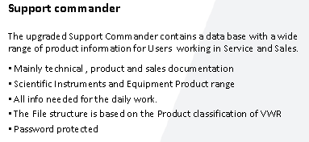
Content of the Commander 2.0 Data Base

Slide 4
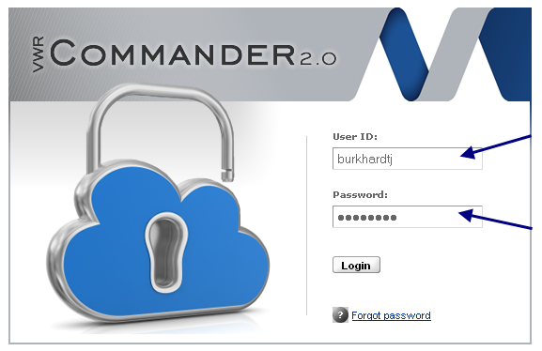
Commander 2.0– Log-On
Support Commander 2.0 Data Base
Log-On
1.1. Get an Internet access, and use the website:
https://ses.vwr-cmd2.com/bin/login?company=
1.2. Your Log-On frame will look like this:
Please watch for correct writing of upper case and lower case characters!
The User-ID, you received by e-mail
!! Your Password !! Is case sensitive !

Slide 5
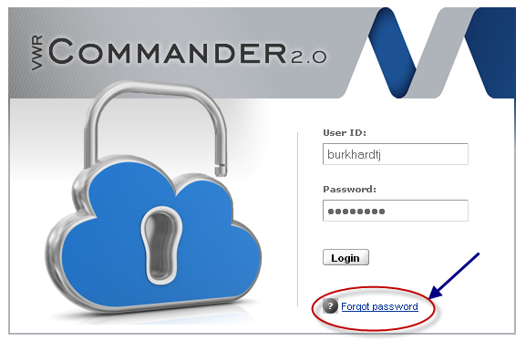
Commander 2.0– Log-On
Please understand, that the access to this Data Base is given to you by VWR International GmbH based on our trust in your loyalty and integrity in handling the information of this Data Base.
Any miss-usage of this access will at once results in an erasure of your account!
1.3. Forgot Password
If you forgot your password , please use this Function :
A mail will be sent to the mail address associated with your user id.

Slide 6
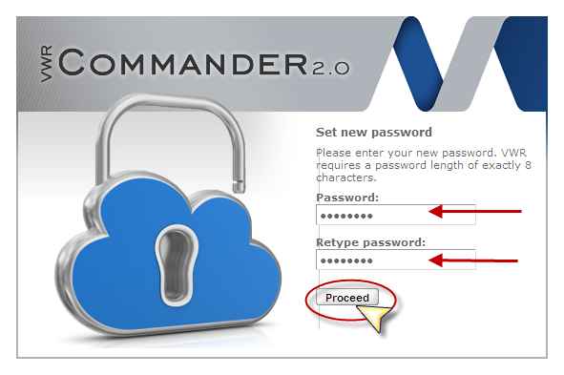
Commander 2.0– Log-On
Following email you will get :
VWR Commander: Password recover
A request was made to set a new password for your account.
Please follow this link to set a new password: https://cr.i1.adama.de/password/verify/wqTAejwWxKNr7RFeM
If you didn't request this mail, please notify VWR e-marketing team.
Regards,
VWR
Set new password: Please enter your new password. VWR requires a password length of exactly 8 characters.

Slide 7
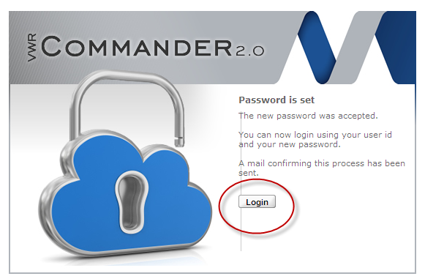
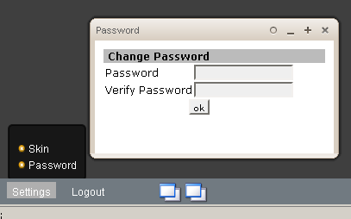
Commander 2.0– Log-On
Confirmation email :
VWR Commander: Password changed - Your password was successfully changed.If you didn't change your password, please notify VWR e-marketing team immediately. Regards, VWR
In addition you can change your password after
Log-On :

Slide 8
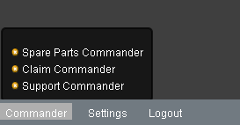
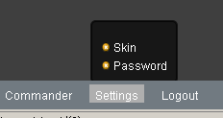
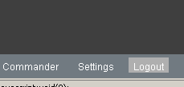
Commander 2.0 – Overview
Main Menue
The Menue of the Commander is located in the lower left part of the frame.
Depending of your User profile you will see following sections :
Commander - Spare Parts Commander - Claim Commander - Support Commander
Settings - Skin - Password
Logout

Slide 9
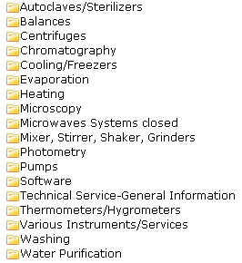
Support Commander – Overview
Support Commander
The Support Commander Data Base is a Tool , which should offer a wide range of information for all kind of Users working in Sales and Service functions.
Mainly technical , product and sales documentation of the Scientific Instruments and Equipment Product range is archived to support VWR people and associated partners to ensure always availability of all necessary information for the daily work.
The File structure is based on the Product classification of VWR .
Depending on your personal User Profile, you will see different /less File Folders
Overview: 1. File Folder Level
The File Folder Names are called “EQUIPMENT GROUPS”

Slide 10
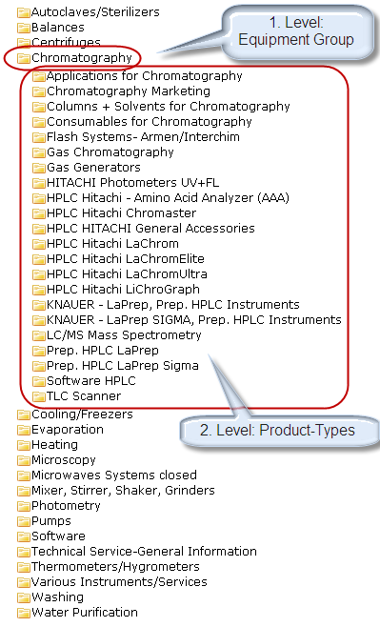
Support Commander – Overview
Support Commander
Overview: 2. File Folder Level
The File Folder Names are called “PRODUCT-TYPES”

Slide 11
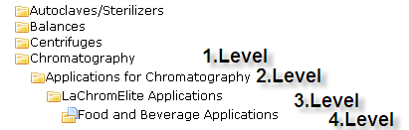
Support Commander – Overview
Support Commander
Overview: 3. and 4. File Sub-Folder Level
These Levels are the Sub-Folders for each Product-Type Archive :
The File Folder Names are called “SUB-FOLDER 3 and 4”

Slide 12
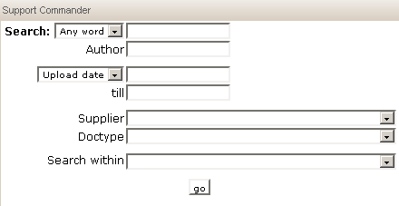
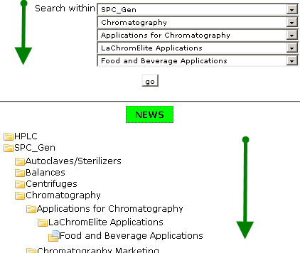
Support Commander – Overview
Support Commander
Search Function
Any Word – All Words: single Words or combination of several words
Author: search for the Author of the individual documents
Upload Date , Valid from Date, Valid until Date
Supplier: Selection of documents of individual Suppliers
Doctype: Selection of individual Document Types
Search within: Search within the different Levels of the Support Commander Archive: depending on the File Folder Structure of the different Segments , the search can be limited to all File Folder levels, for example

Slide 13
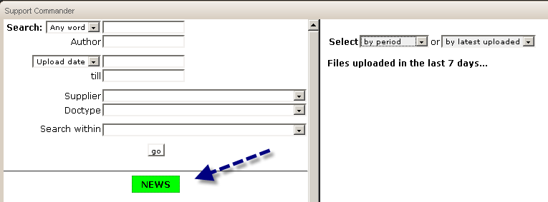
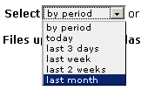
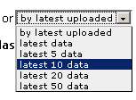
Support Commander – Overview
Support Commander
News
By default you will see the latest Uploads of the recent 7 days
Press the News-Button and you will get a overview of the latest Uploads filtered by different criteria:
by period
by latest upload

Slide 14
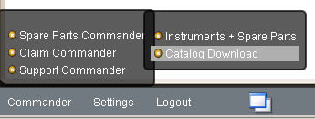

Spare Parts Commander – Overview
Spare Parts Commander
Spare Parts Commander Data Base is a Tool , which includes Instruments and Spare Parts Data of all different products , which VWR has registered in the system and can offer for Sales and service.
The File structure is based on the Product classification of VWR . Several List or Catalog-output functions are available , like PDF or Excel export….
Search/Filter function offers these possibilities:
Instruments and Spare Parts
Instruments only
Spare Parts only
In addition there are additional filters available , like Status , Supplier Product Type and Equipment Group
Recommended Parts ( for maintenance)

Slide 15
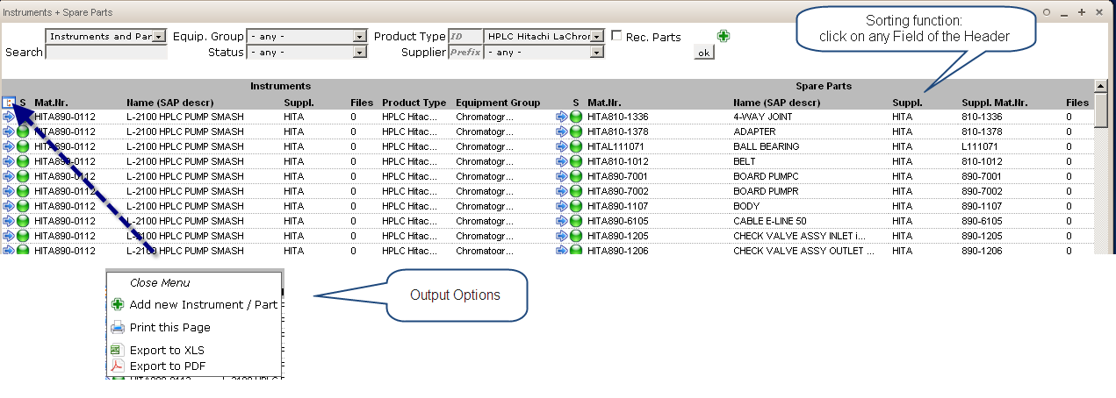
Spare Parts Commander – Overview
Spare Parts Commander
Below the Search function you can open an additional Menue for Output Options !

Slide 16
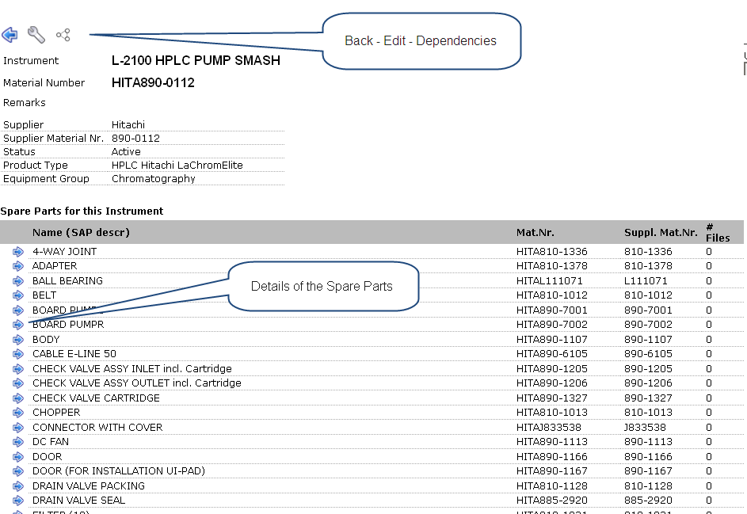
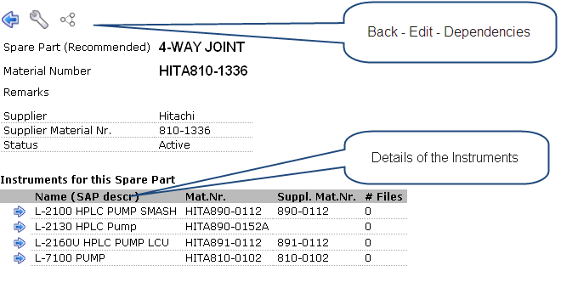
Spare Parts Commander – Overview
Spare Parts Commander
Details of the Instrument Datas:

Slide 17
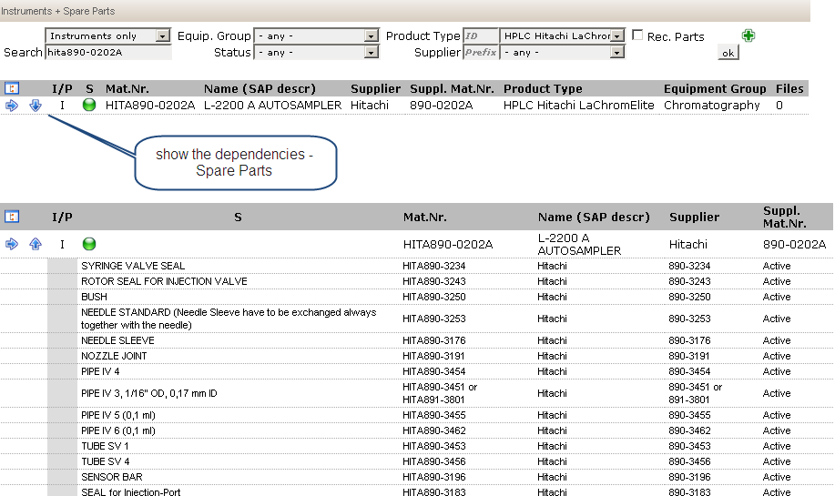
Spare Parts Commander – Overview
Spare Parts Commander
Details of the Spare Parts Datas:
Select Instruments including dependencies – Spare Parts

Slide 18

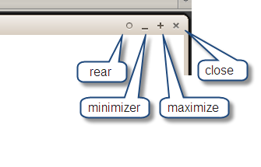
Commander – Overview
Special Functions
Keyboard:
F5 Refresh the Commander Application
F11 Full Screen
Main Menue:
Switch to other active applications

Slide 19
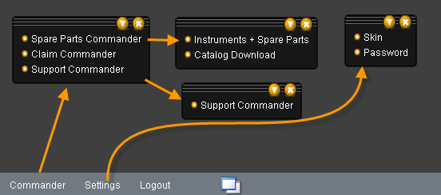
Commander – Overview
Special Functions
Flexible Menue :
You can open the Menue multiple times and fix it anywhere on the screen for easy navigation to other applications

